Slide 1
MACOM Diode Products – AlGaAs Control Products rev 1
Joe Bukowski, Rick Cory
23 March 2017

Slide 2
Product Families
PIN/NIP Diodes:
Switching
Attenuation
Limiting
Varactor Diodes:
Tuning
Phase Shifting
Schottky Diodes:
Detection
Frequency Mixing
Diode Products
Attenuators
Multiplier Diodes:
Frequency Multiplication
Waveshaping
Passive Devices
RF Chokes/Inductors
MNS Capacitors
Resistors

Slide 3




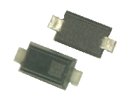
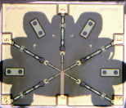
Product Configurations
Discrete Device
Beam Lead/ Flip Chip
(to 70+ GHz)
HMIC Discrete Surmount
(to 26.5GHz)
Plastic
(to 6 GHz)
Integrated Solutions

Slide 4
AlGaAs PIN Process
PIN Diode Circuits

Slide 5
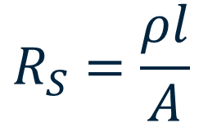
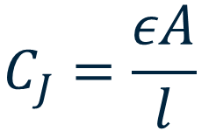
PIN Diodes at mmW – the Classic Conundrum
At very high frequencies (>25 GHz) the carrier mobility of Si causes series resistance to increase significantly with increasing frequency
The higher carrier mobility of III-V compound semiconductors makes them preferable at mmW
BUT
We still see junction capacitance and series resistance of PIN structures governed by diode geometry
Junction capacitance must be very small, typically accomplished by reducing the area of the junction
Reduced junction area produces increased series resistance
$$C_{J}=\frac{εA}{l}$$
$$R_{S}=\frac{ρl}{A}$$

Slide 6
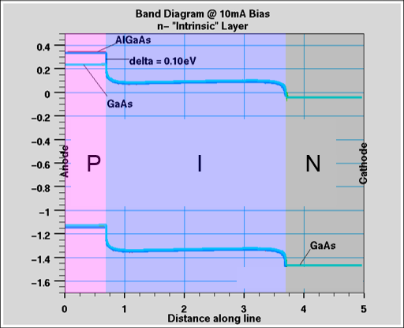
Why AlGaAs?
The addition of Al as a p-type dopant in the anode layer of the PIN structure
Is patented by MACOM
Increases the bandgap with respect to GaAs
Creates a barrier to hole “back injection” from the I layer into the P layer
Enhances forward injection of holes from the P layer to the I layer
Results in higher charge concentration in I layer under forward bias
Source: Boles, T. et al, AlGaAs mmW PIN Diode Switch: A New Benchmark for Power Handling

Slide 7
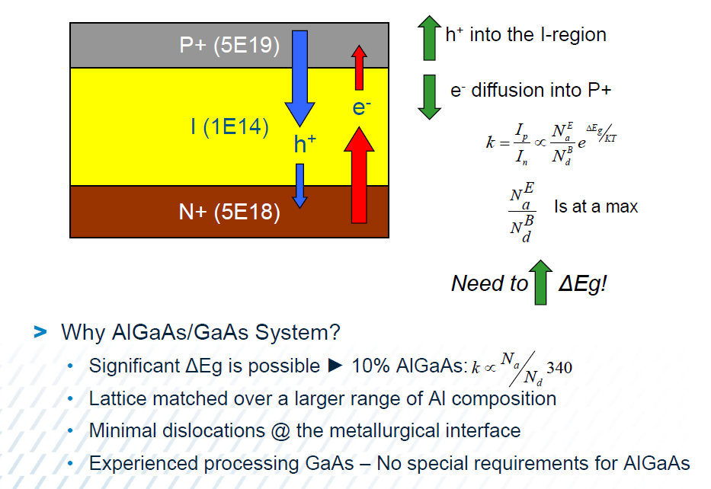
How to Increase Charge in the I Layer?

Slide 8
Why AlGaAs (cont’d)?
Al dopant
reduces diode forward-bias series resistance
has no effect on nonconduction state characteristics
junction capacitance of AlGaAs junction the same as physically-identical GaAs junction capacitance
Demonstrated a 37% reduction in Rs, and no change in junction capacitance
Confirmed by fabricated device measurements and simulations
Extends the use of the PIN structure through 100+ GHz
Source: Boles, T. et al, AlGaAs mmW PIN Diode Switch: A New Benchmark for Power Handling

Slide 9
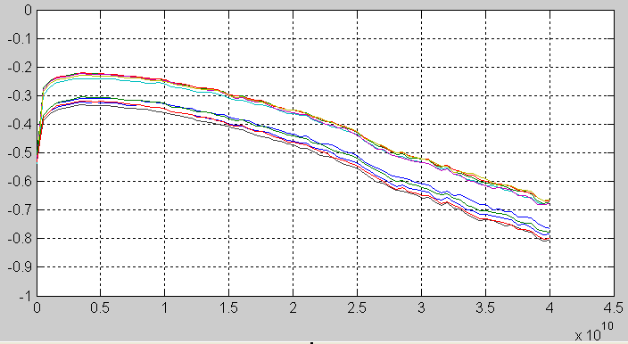
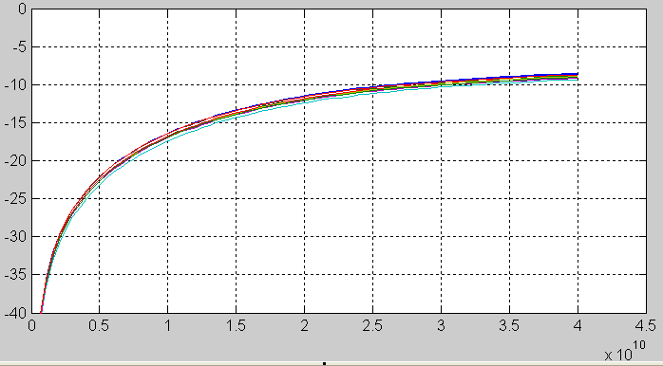
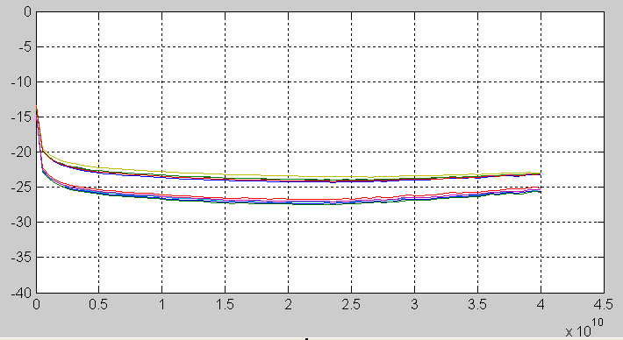
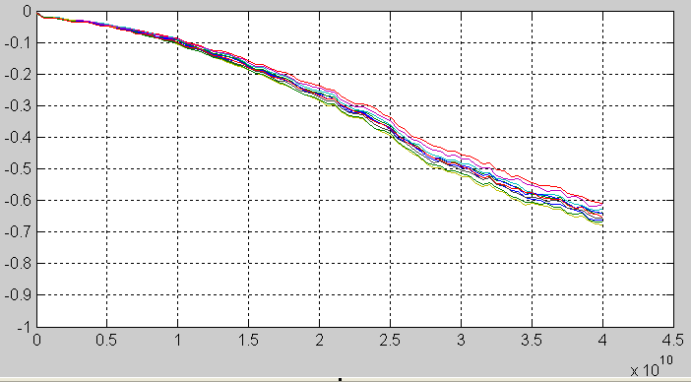
Rs Reduction & Isolation Validation
Series Loss (dB) vs Freq @ 10mA
Shunt Isolation (dB) vs Freq @ 10mA
Series Isolation (dB) vs Freq @10V
Shunt Loss (dB) vs Freq @ 10V
AlGaAs
GaAs
GaAs
AlGaAs
Source: Boles, T. et al, AlGaAs mmW PIN Diode Switch: A New Benchmark for Power Handling

Slide 10
Power Handling/Switch Topology
Series Element Switch
Peak Junction Temperature Dominated by Insertion Loss/I²R Losses
IL is Direct Function of Device Series Resistance & Incident Power
Primarily RF Drive Power
Easily 10%-20% (0.5dB-1.0dB) of Incident Power
DC Bias Power Very Minor Contributor
Very Broadband/ISO is Function of Frequency
Shunt Element Switch
RF Energy Path NOT through Device
Peak Junction Temperature
RF Isolation Leakage
DC Bias Power
I²R Losses in Metallic Airbridges
All have Relatively Minor Heating Effect
Switch IL a Function C_{J}, NOT Series Resistance
Multi-Throw Shunt Switch Limitation
Bandwidth ≈1 Octave
λ/4 Bias Structures
RF Power Handling
All Shunt Switch => Highest RF Power Handling
Essentially NO Intrinsic RF Losses in Active Semiconductors
Only RF Loss - Metallic Conductors & Capacitive Isolation
Source: Boles, T. et al, AlGaAs mmW PIN Diode Switch: A New Benchmark for Power Handling

Slide 11
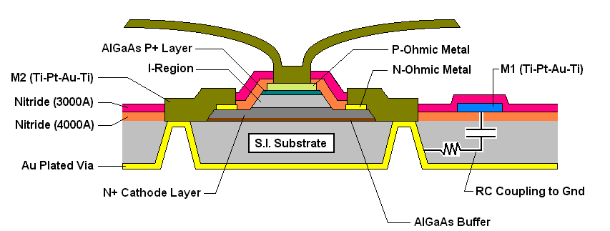
AlGaAs Shunt PIN Diode Structure
3 μm
Nitride
MACOM AlGaAs switches are shunt-diode only
Active diode layers are built upon semi-insulating (SI) GaAs substrate
Electrical connection from cathode (n-layer) to backside of wafer is accomplished by through wafer vias (TWVs)
I layer thickness = 3 µm
Source: Boles, T. et al, AlGaAs mmW PIN Diode Switch: A New Benchmark for Power Handling

Slide 12
AlGaAs PIN Diode Products
Switching

Slide 13
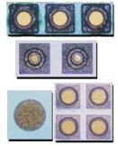
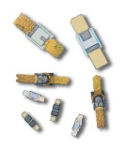

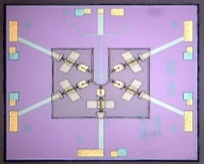
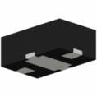
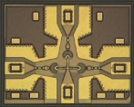

PIN Diode Families
Si Discrete | Si HMIC™ | GaAs | AlGaAs
Wide operating frequency range, to 20 GHz Excellent power handling PIN and NIP diodes available I layer: 2 – 300 µm Available as: Unpackaged chips SMT packages Ceramic Packages Beam leads | Very Wide operating frequency range, to 30 GHz I layer: 8 – 100 µm Available as Single junction devices Multiple junction ICs Wire-bondable or solderable | Wide operating frequency range, to 30 GHz Good power handling Available as: Unpackaged chips SMT packages Ceramic Packages Beam leads | Extremely wide operating frequency range, to 100 GHz Lower insertion loss than comparable Si or GaAs switches I layer: 3 µm Available as Multiple junction ICs Wire-bondable

Slide 14
PIN Switches
Modules Single-Chip

Slide 15
AlGaAs Products
Topology | Frequency (GHz) | Insertion Loss (dB) | Isolation (dB) | P_{1dB} (dBm) | Reflective or Absorptive | Bias (mA) | Part Number | Package
SPST | 0.05 - 18 18 – 50 | 0.2 0.3 | 22 46 | 23 | Reflective | 10 | MA4AGSW1 | DIE
SPST | 10-50 | 1.2 | 30 | 23 | Absorptive | 10 | MA4AGSW1A | DIE
SP2T | 0.05 - 18 18 – 50 | 0.5 0.7 | 47 33 | 23 | Reflective | 10 | MA4AGSW2 | DIE
SP3T | 0.05 - 18 18 – 50 | 0.6 0.8 | 45 31 | 23 | Reflective | 10 | MA4AGSW3 | DIE
SP4T | 0.05 - 18 18 – 50 | 0.7 1.0 | 41 32 | 23 | Reflective | 10 | MA4AGSW4 | DIE
SP5T | 0.05 - 18 18 – 50 | 1.4 1.9 | 35 30 | 23 | Reflective | 10 | MA4AGSW5 | DIE
SP8T | 0.05 - 18 18 - 50 | 1.5 2.0 | 32 32 | 23 | Reflective | 10 | MA4AGSW8-1 | DIE

Slide 16
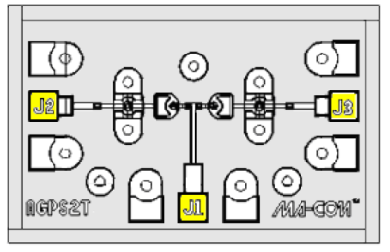
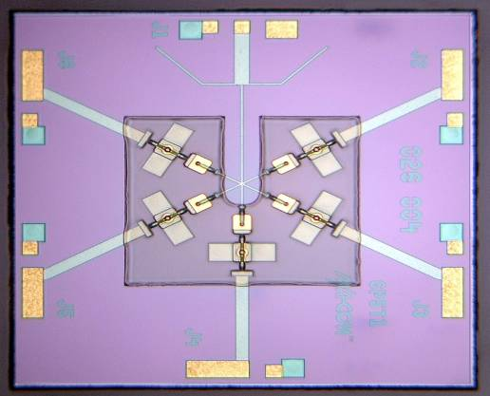
AlGaAs PIN Diode Switches
Product Offering
SPST to SP8T
Features
Operating Frequency = 50 MHz - 70 GHz
Maximum RF Average Incident Power = 0.25 W CW
AlGaAs ~ 0.3 dB Lower IL (20 GHz) vs. GaAs & Si Switches
Very Low Insertion Loss
Excellent Isolation
Low Switching Time
SP2T
SP5T
SPST

Slide 17
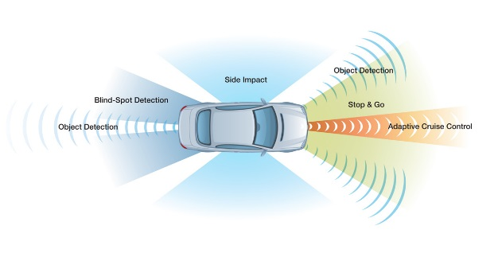
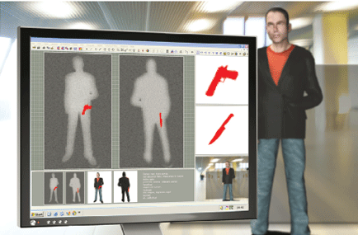
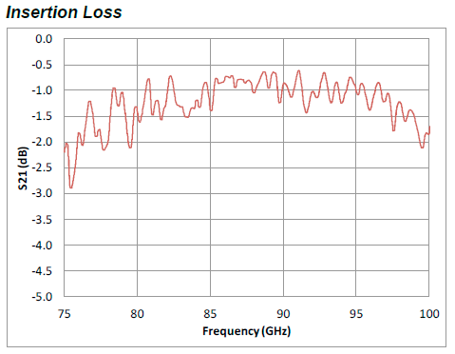
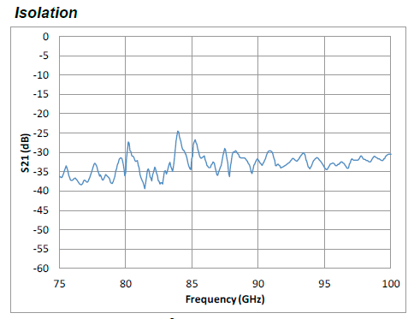
AlGaAs SP3T W Band Switch MASW-011029
Broadband Operating Frequency: 60 - 110 GHz
Insertion Loss:1.3 dB Typical
Isolation: 33 dB Typical
Silicon Nitride Passivation
BCB Scratch Protection
Collision Avoidance Radar
Passive Imaging

Slide 18
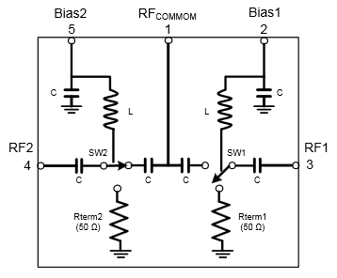
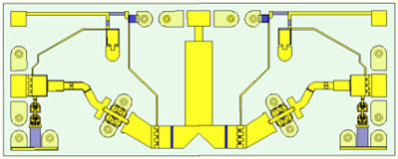
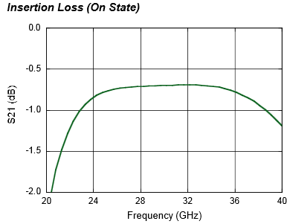
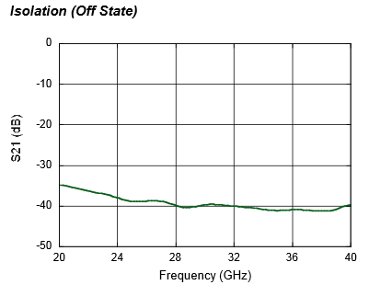
MASW-011036 Ka-Band High Power Terminated AlGaAs SPDT PIN Switch
Broadband Performance: 26 to 40 GHz
Low Loss <1 dB; High Isolation >38 dB
Up to 13 W CW Power, 85 °C
Die with G-S-G RF Pads and DC Bias Pads
Includes DC Blocks and RF Bias Networks
23 dBm power handling in terminated port
Notes:
Delete specs table?

Slide 19
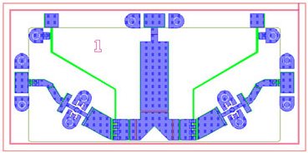
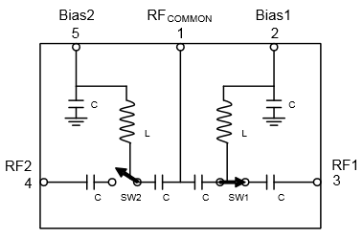
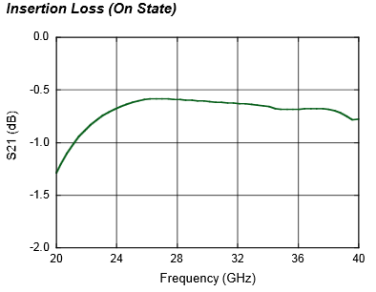
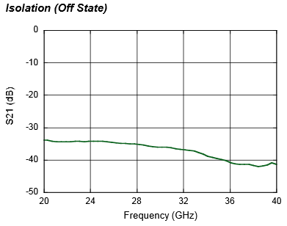
MASW-010646 Ka-Band High Power Reflective AlGaAs SPDT PIN Switch
Broadband Performance: 26 to 40 GHz
Low Loss: 0.6 dB
High Isolation: 32 dB
Up to 13 W CW Power, 85 °C
Die with G-S-G RF Pads and DC Bias Pads
Includes DC Blocks and RF Bias Networks
Notes:
Delete specs table?

Slide 20
Thank You

Slide 21
Appendix

Slide 22
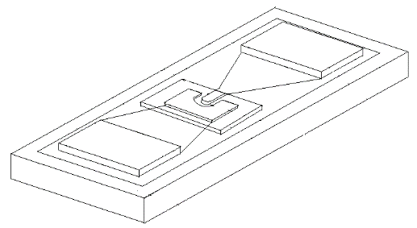
Flip Chip Products
Low Capacitance Devices
PIN Diodes | Configuration | Max Frequency | Breakdown Voltage Vb | Ct Max | Rs Typical | Material
 |  | (GHz) | (V) | (pf) | (Ω)
MA4GP907 | Single | 40 | 45 | 0.025 | 4.2 | GaAs
MA4AGP907 | Single | 50 | 50 | 0.020 | 4.2 | AlGaAs
MA4FCP200 | Single | 40 | 50 | 0.015 | 2.8 | HMIC
MA4FCP300 | Single | 30 | 70 | 0.025 | 2.6 | HMIC
MA4FCP305 | Single | 18 | 40 | 0.050 | 2.1 | HMIC
Varactor Diodes | Configuration | Max Frequency | Breakdown Voltage Vb | Ct 4V | Gamma | Material
 |  | (GHz) | (V) | (pf)
MA46H146 | Single | 60 | 26 | 0.033-0.06 | 1 | GaAs
MA46H120 | Single | 60 | 15 | 0.20-0.40 | 0.5 | GaAs

Slide 23
HMIC and AlGaAs MMIC Performance Comparison
Parameter | HMIC | AlGaAs
Products | Switches, Attenuators, Limiters | Switches
Medium | Silicon and Glass | Semi-Insulating GaAs
Die Thickness (um) | 125 | 100
Intrinsic Length (um) | 8 to 100 | 3
I/O Connections | Wire Bondable and SMT | Wire Bondable Only
Passive R,L,C Integration | Yes | Yes
Breakdown Voltage (V) | 50 to 200 | 70
F (GHz) | 0.050 - 30 | 0.050 - 70
Insertion Loss at 10 GHz (SP4T) | 0.6 | 0.45
Switching Speed (ns) | 100 | 15
IIP3 (dBm) | 45 | 25
CW Power Handling, @ 2 GHz (dBm) | +38 | +28

